Slide 1
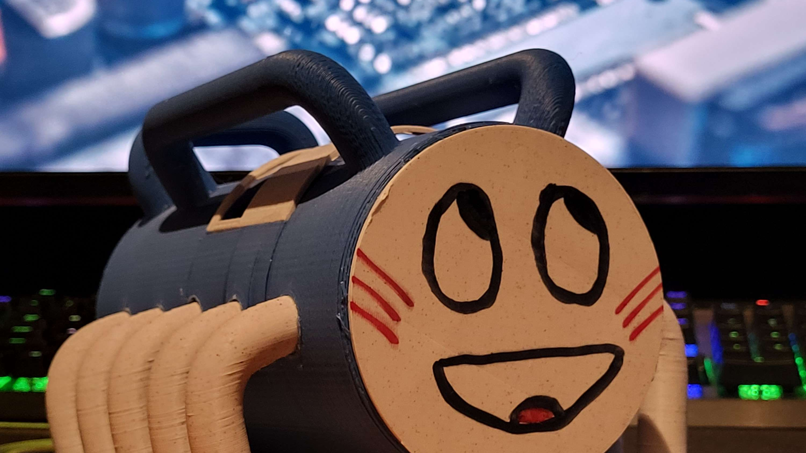
Soldering station
“anyone who has never made a mistake has never tried anything new” ~ Albert Einstein
Notes:
Oh hi mark

Slide 2
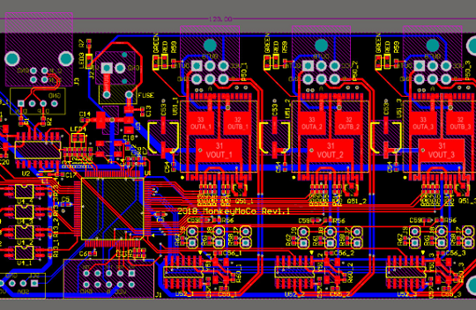
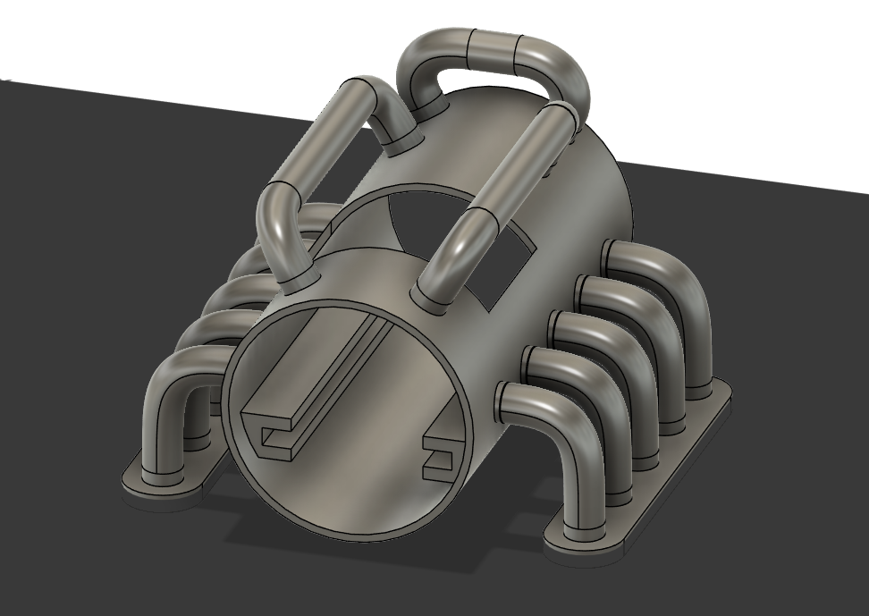

Design
Schematic design
PCB design
Case design
Notes:
How tha designing went

Slide 3
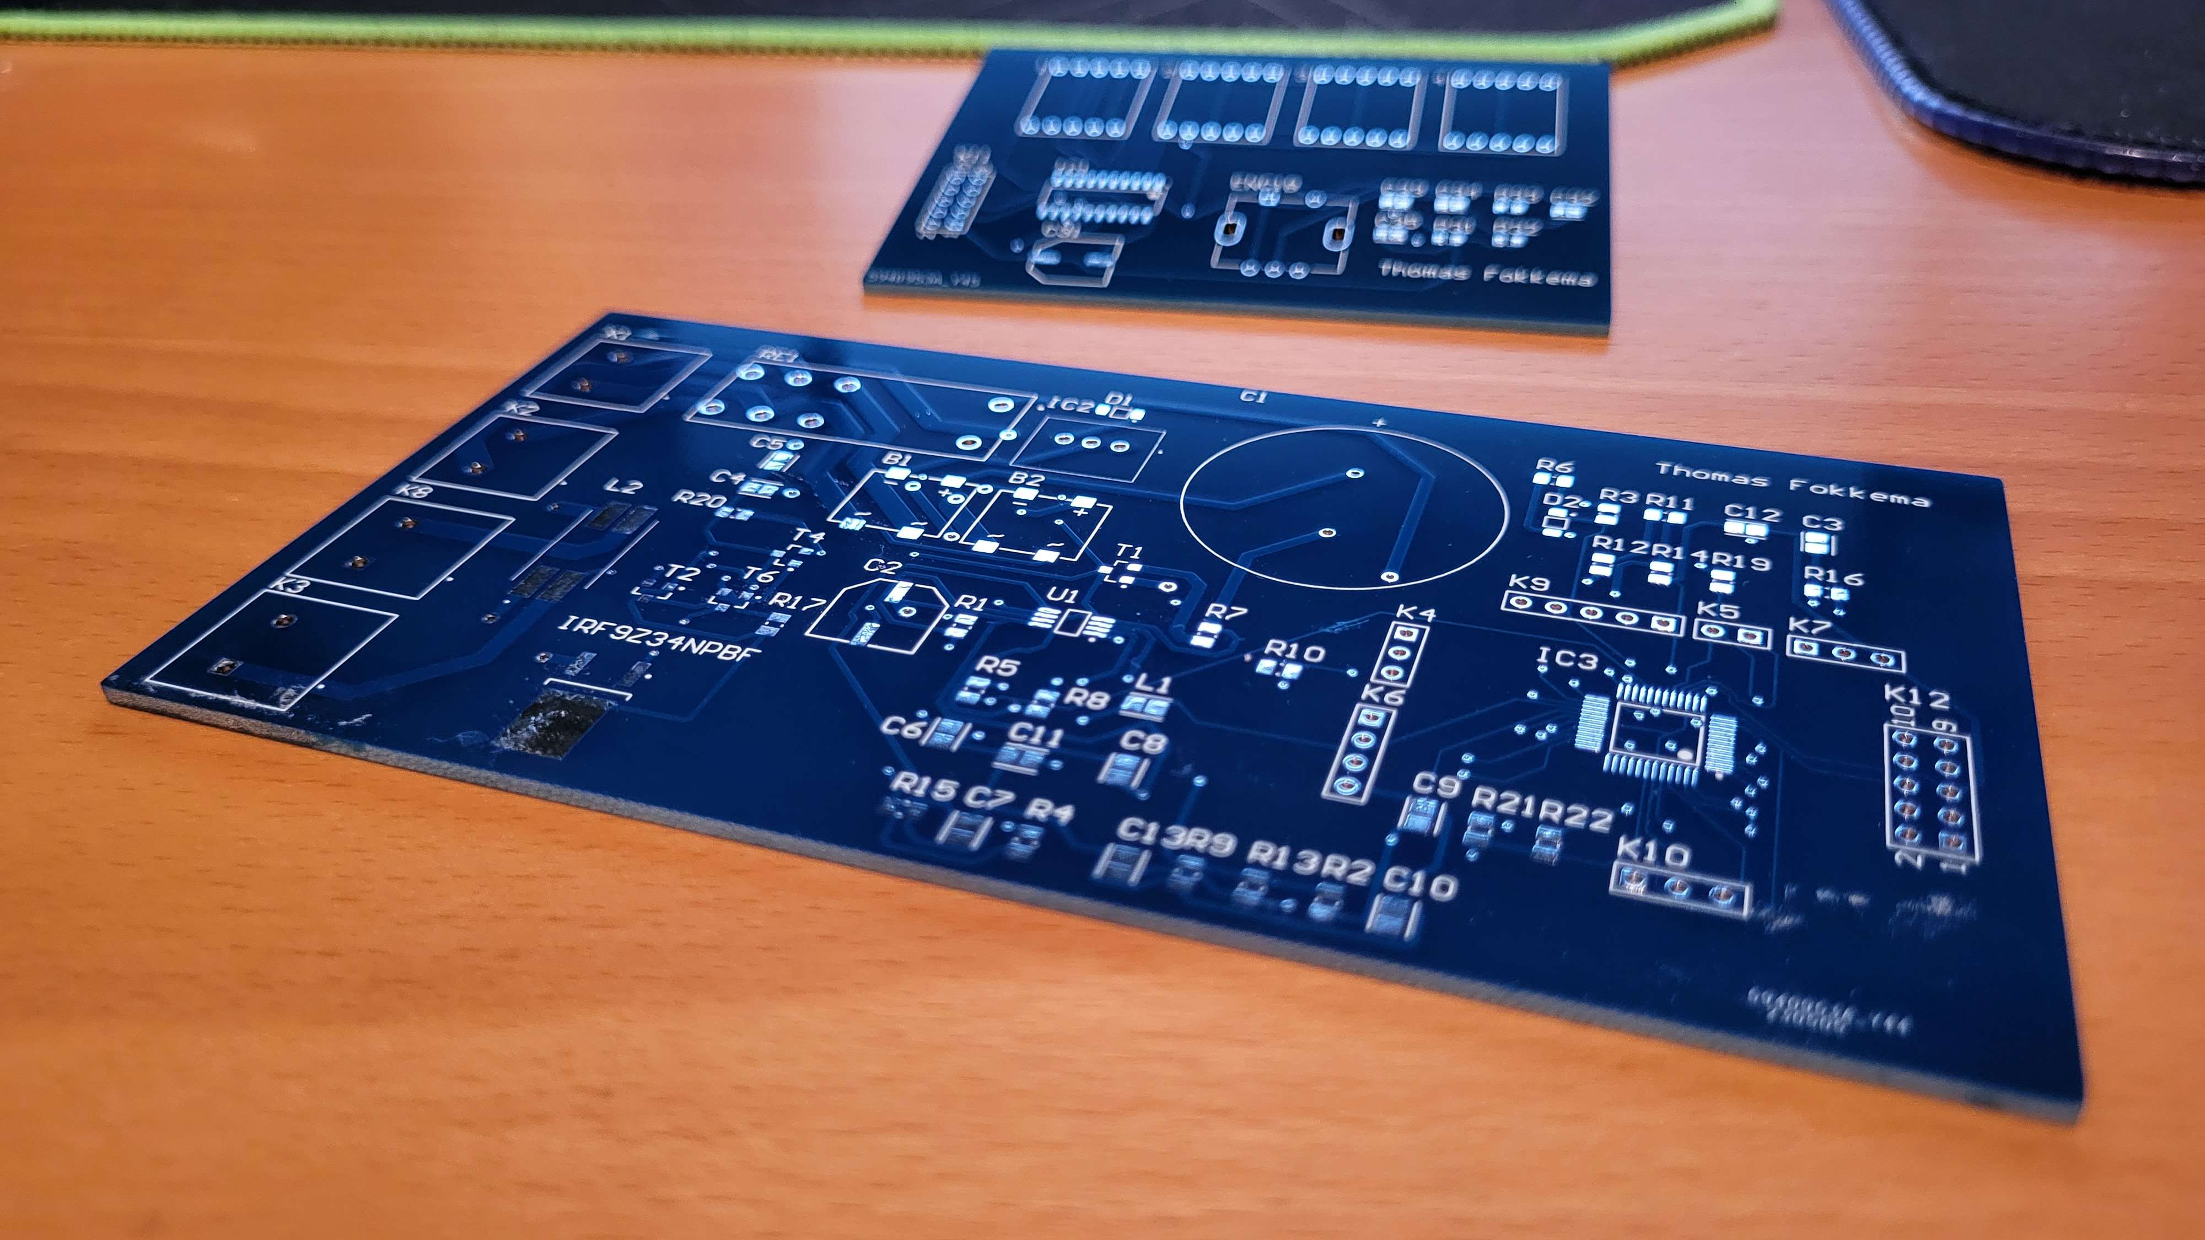
Soldering
Notes:
Reflow oven hand soldering

Slide 4
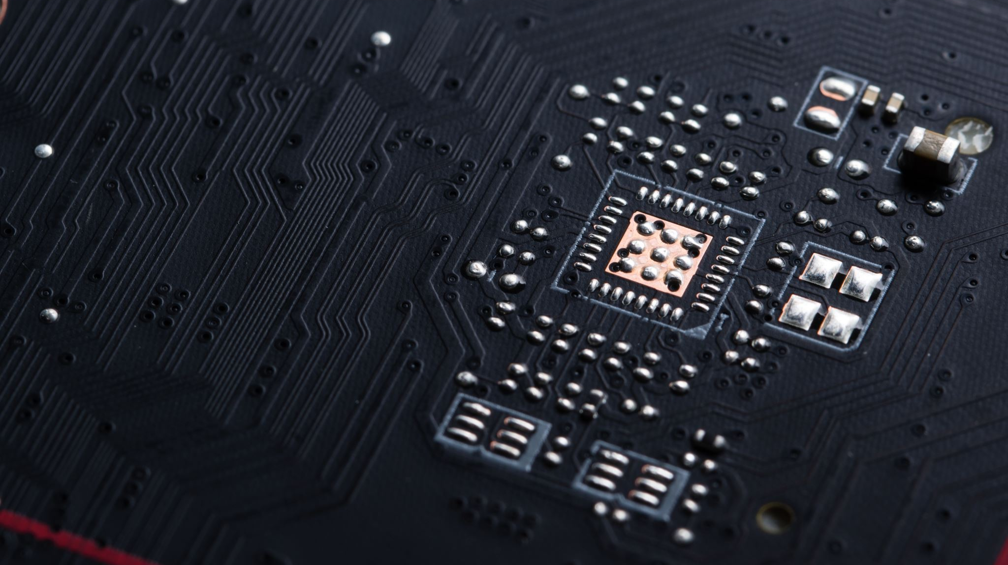
Testing
Notes:
It blew up basicly it is programmed but non functional

Slide 5
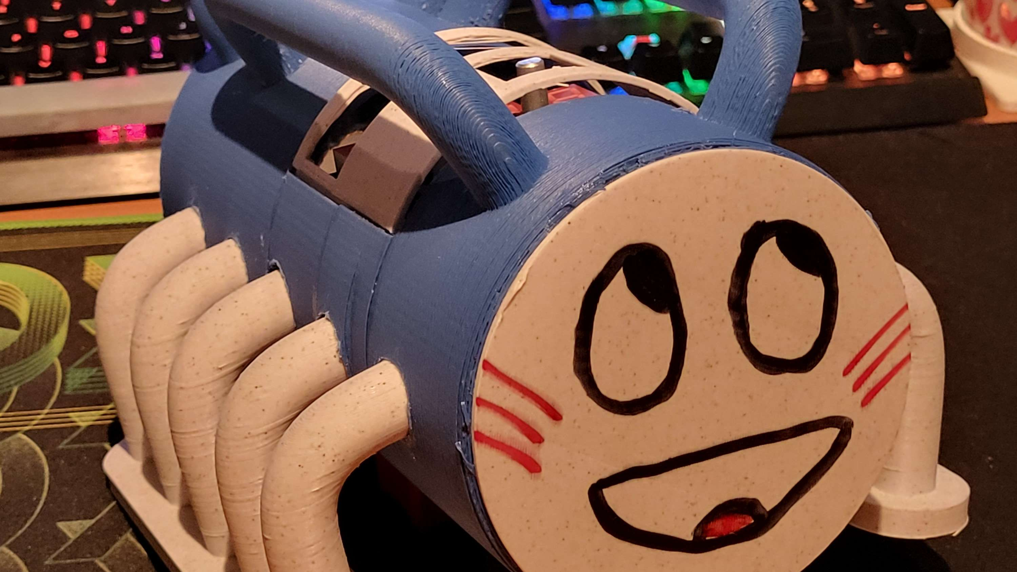
reflection
What went good
What went wrong
Notes:
Good things where the case printing delivery of pcb. Wrong: blew up, mistakes in design, forgot to draw program port next time il have more experience en wil do it better

Slide 6

Any Questions?
Notes:
Thank u for your attention

